Slide 1
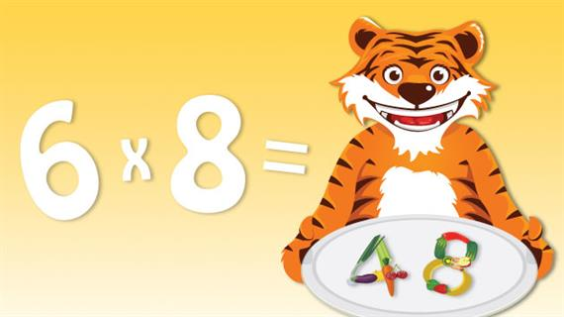
DATE: 05/11/2018
WEEK 1
UNIT 2
MULTIPLICATION AND DIVISION
Dr. Jai Shanker Pillai H P, M.Sc., M.Phil, B.Ed, Ph.D, FBSS
Senior Faculty
Royal British International School
Yangon, Myanmar
Mobile: +959789813903, Whatsapp:+919606428389
Email: pillai@royalbritishintenational.com
drjaishankerpillai@gmail.com

Slide 2
LESSON 1
MULTIPLYING BY 9, 99 USING 10, 100 AND ADJUSTING
MULTIPLY NUMBERS MENTALLY DRAWING UPON KNOWN FACTS
Example
43 X 10 = 43

Slide 3
Challenge 1
Multiply each number by 10
a) 23 X 10 = 230
b) 47 X 10 = 470
c) 72 X 10 = 720
d) 58 X 10 = 580
e) 84 X 10 = 840

Slide 4
2. Multiply each number by 100
Example
43 X 100 = 4300
39 X 100 = 3900
77 X100 =7700
28 X 100 =2800
85 X 100 =8500
46 X 100 = 4600

Slide 5
Challenge 2
Multiply each number by 9. Multiply by 10 first, then adjust to
find the answer.
Example
43 X 9 = (43 X 10) - 43
= 430 – 43
= 387

Slide 6
67 X 9 = (67 X 10) – 67
= 670 – 67
= 603
89 X 9 = (89 X10) -89
= 890 – 89
= 801
d) 37 X 9 = (37 X 10) -37
= 370 -37
= 333
c) 69 X 9 = (69 X 10) -69
= 690 -69
= 621
e) 63 X 9 = (63X10) -63
= 630 -63
= 567

Slide 7
34 X 9 = (34 X 10) – 34
= 340 – 34
= 306
45 X 9 = (45 X10) - 45
= 450 – 45
= 405
h) 58 X 9 = (58 X 10) -58
= 580 -58
= 522
74 X 9 = (74 X 10) -74
= 740 -74
= 666
j) 92 X 9 = (92 X 10) - 92
= 920 -92
= 828

Slide 8
Challenge 2
2. Multiply each number by 99.
Multiply by 100 first, then adjust to find the answer
Example
43 X 99 = (43 X100) -43
= 4300 – 43
= 4257

Slide 9
46 X 99 = (46 X 100) -46
= 4600 – 46
= 4554
37 X 99 = (37 X 100) -37
= 3700 -37
= 3663
c) 25 X 99 = (25 X 100) -25
= 2500 -25
= 2475
d) 74 X 99 = (74 X 100) – 74
= 7400 -74
=7326
e) 93 X 99 = (93 X 100) -99
= 9300 -99
=9201

Slide 10
83 X 99 = (83 X 100) -83
= 8300 – 83
= 8217
g) 58 X 99 = (58 X 100) -58
= 5800 -58
= 5742
h) 62 X 99 = (62 X 100) -62
= 6200 -62
= 6138
41 X 99 = (41 X 100) – 41
= 4100 -41
= 4059
j) 86 X 99 = (86 X 100) -86
= 8600 -86
=8514

Slide 11
3. Use a calculator to work out the answers to
these calculations. What patterns do you notice?
Predict what the next answer in the pattern will be.
9 X 9 = 81
9 X 99 =891
9 X 999 = 8991

Slide 12
Challenge 3
Work out the calculations below. Two slightly different strategies are required. Sort the calculations into two sets, one set for each strategy.
Explain your reasoning.
45 X 9 = 405 g) 67 X 9 =603
84 X 9 = 756 h) 75 X 9 = 675
63 X 9 = 567 i) 26 X 9 =234
d) 72 X 9 = 648 j) 37 X 9 = 333
e) 56 X 9 = 504 k) 68 X 9 = 612
f) 78 X 9 = 702 l) 53 X 9 = 477

Slide 13
Challenge 3.
2. Find a mental strategy to help you work out the answers to these
calculations
35 X 199 = 6,965 g) 18 X 298 = 5,364
33 X 299 = 9,867 h) 32 X 499 = 15,968
54 X 198 = 10,692 i) 41 X 297 = 12, 177
26 X 198 = 5,148 j) 43 X 298 = 12,814
15 X 396 = 5,940 k) 64 X 399 = 25,536
22 X 397 = 8,734 l) 81 X 598 = 48,438

Slide 14
Challenge 3
3. Use a calculator to work out the answers to these calculations.
What patterns do you notice?
Predict what the next answer in the pattern will be when your calculator display is not big enough
99 X 99 = 9801
999 X 999 = 998001
9999 X 9999 = 99980001

