Slide 1
Vocabulary cards

Slide 2
Hundreds
TOP Maths Stage 3 © 2016 Alston Publishing House Pte Ltd

Slide 3
Hundreds
Example: 2 hundreds = 200
We can say that the value of 2 hundreds is the same as 200.
TOP Maths Stage 3 © 2016 Alston Publishing House Pte Ltd

Slide 4
One thousand
TOP Maths Stage 3 © 2016 Alston Publishing House Pte Ltd

Slide 5
Regroup
TOP Maths Stage 3 © 2016 Alston Publishing House Pte Ltd

Slide 6
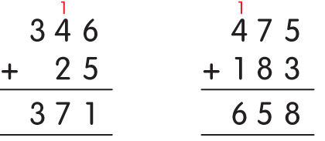
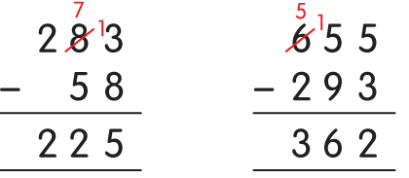
Regroup
We need to regroup in a place value when
- we get more than 9 after adding; or
- we subtract a greater number from a smaller number.
Example:
TOP Maths Stage 3 © 2016 Alston Publishing House Pte Ltd

Slide 7
Round to the nearest hundred
TOP Maths Stage 3 © 2016 Alston Publishing House Pte Ltd

Slide 8
Round to the nearest hundred
When we round a number to the nearest hundred, we look at the digit in the tens place.
(a) If the digit < 5, we round to the smaller hundred.
(b) If the digit > 5, we round to the bigger hundred.
(c) If the digit = 5, we round to the bigger hundred.
Example:
TOP Maths Stage 3 © 2016 Alston Publishing House Pte Ltd

Slide 9
Round to the nearest ten
TOP Maths Stage 3 © 2016 Alston Publishing House Pte Ltd

Slide 10
Round to the nearest ten
When we round a number to the nearest ten, we look at the digit in the ones place.
(a) If the digit < 5, we round to the smaller ten.
(b) If the digit > 5, we round to the bigger ten.
(c) If the digit = 5, we round to the bigger ten.
Example:
TOP Maths Stage 3 © 2016 Alston Publishing House Pte Ltd

Slide 11
Between
TOP Maths Stage 3 © 2016 Alston Publishing House Pte Ltd

Slide 12
Between
Example:
265 is exactly between 260 and 270.
TOP Maths Stage 3 © 2016 Alston Publishing House Pte Ltd

Slide 13
Estimate
TOP Maths Stage 3 © 2016 Alston Publishing House Pte Ltd

Slide 14
Estimate
A reasonable guess of the actual number.
TOP Maths Stage 3 © 2016 Alston Publishing House Pte Ltd

Slide 15
Range
TOP Maths Stage 3 © 2016 Alston Publishing House Pte Ltd

Slide 16
Range
A range of numbers is a set of numbers.
Example:
The range ‘30 to 40’ includes the following numbers: 30, 31, 32, 33, 34, 35, 36, 37, 38, 39 and 40.
TOP Maths Stage 3 © 2016 Alston Publishing House Pte Ltd

Slide 17
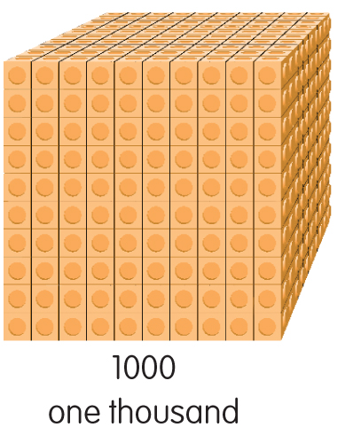
One thousand
Example:
Ten hundreds = One thousand
TOP Maths Stage 3 © 2016 Alston Publishing House Pte Ltd

